Slide 1
Struggle creating a New React App
arnaud.nauwynck@gmail.com

Slide 2
new project using React + Next.Js

Slide 3
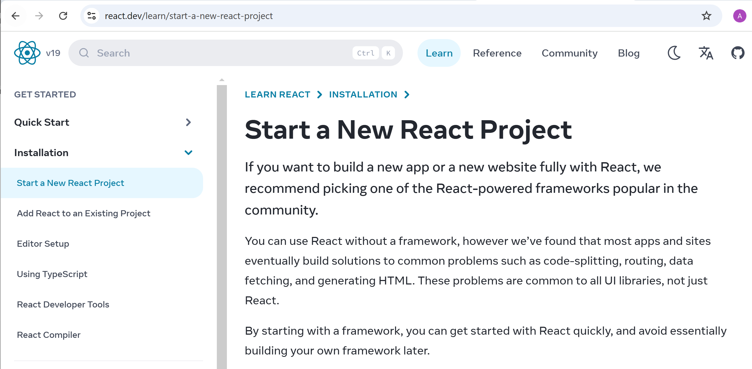
New React Project + choose a Framework

Slide 4
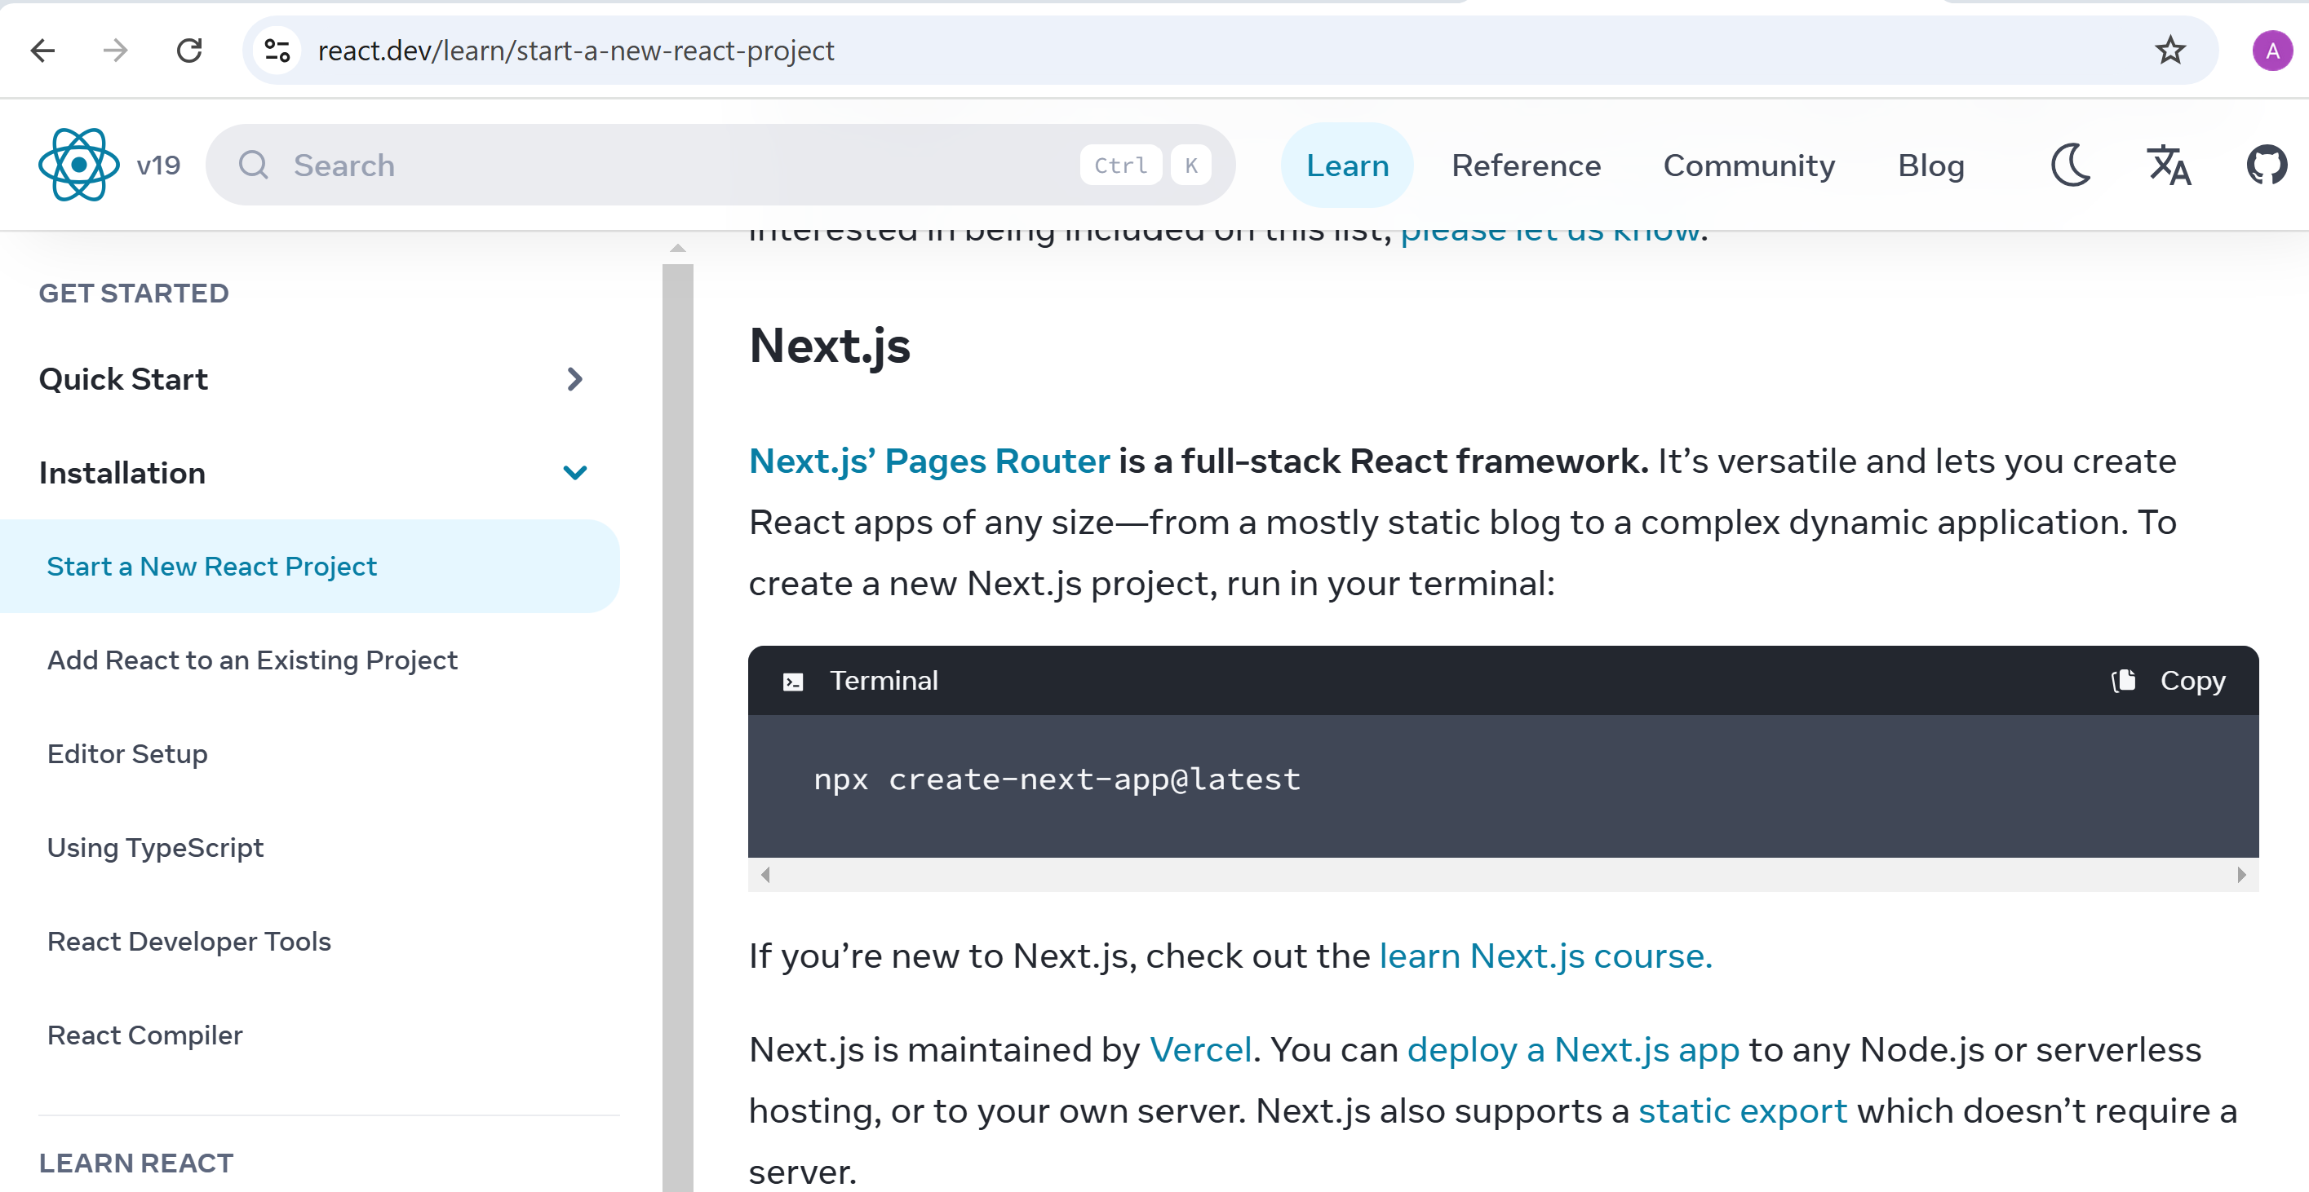
Next.JS

Slide 5
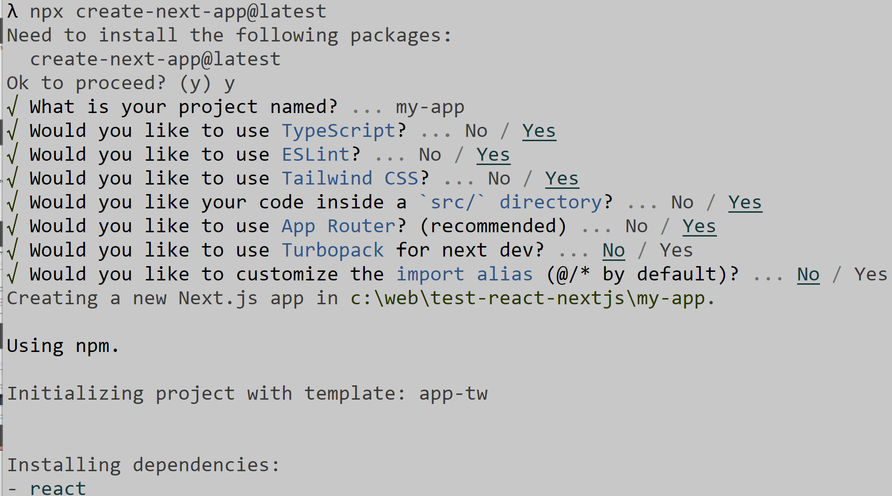
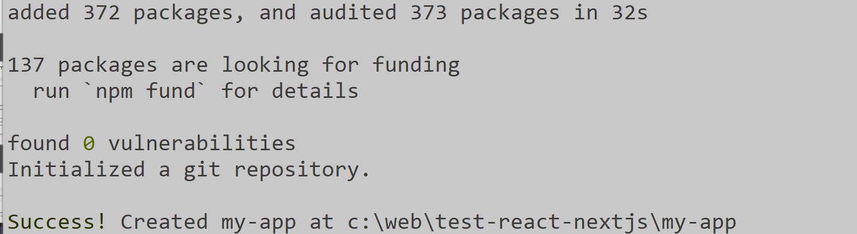
npx create-next-app@latest

Slide 6
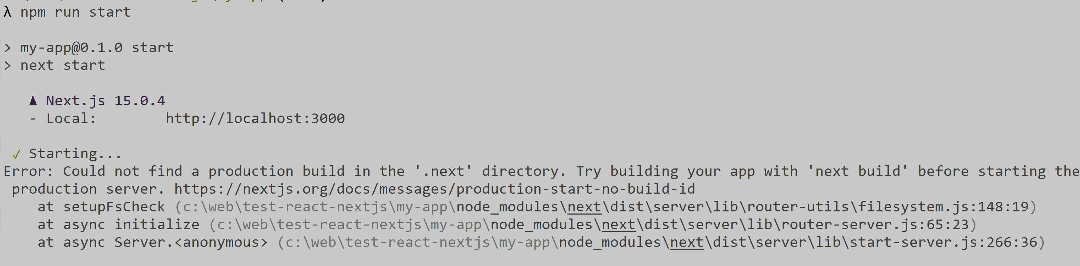
Joke ?

Slide 7
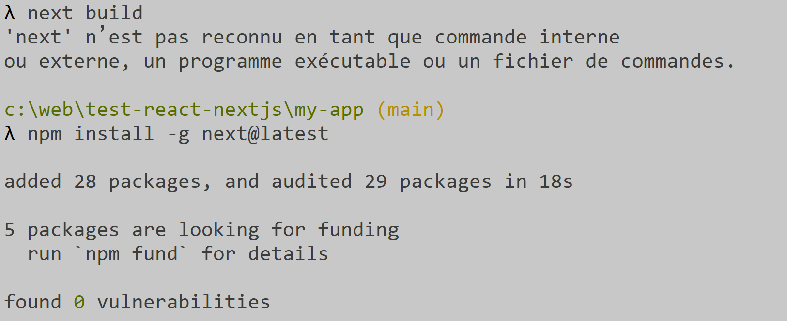
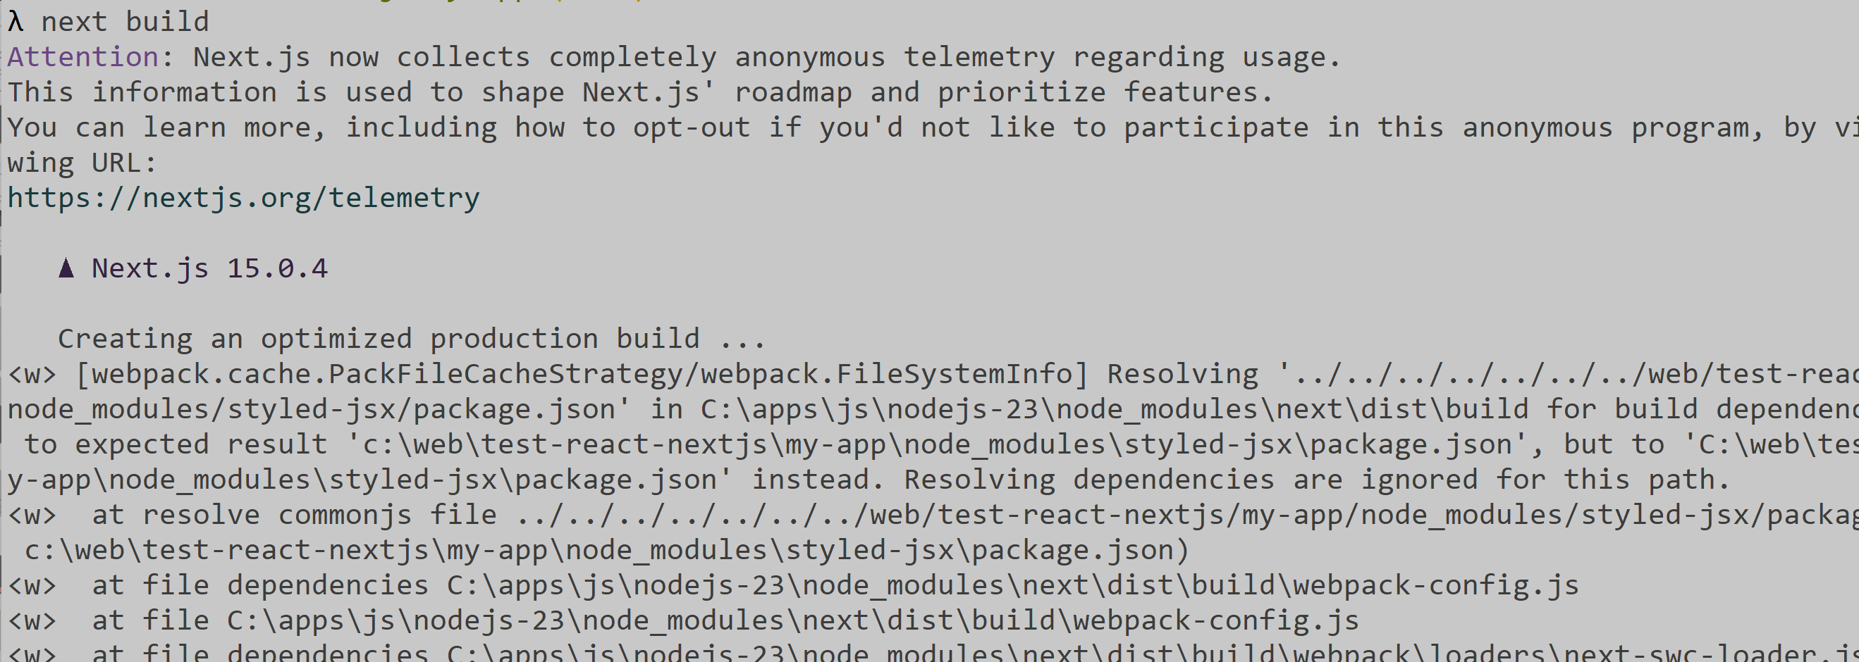
Joke ?

Slide 8
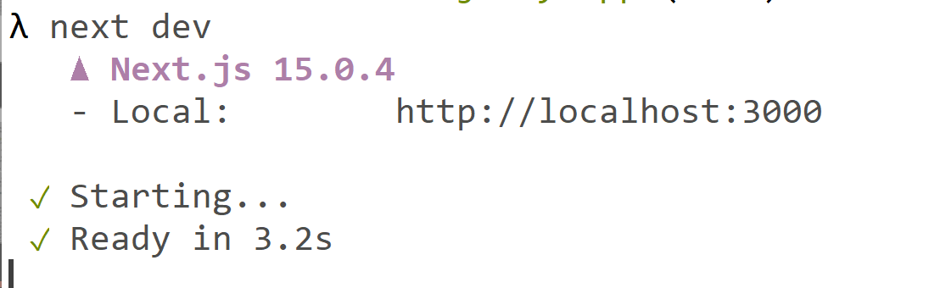
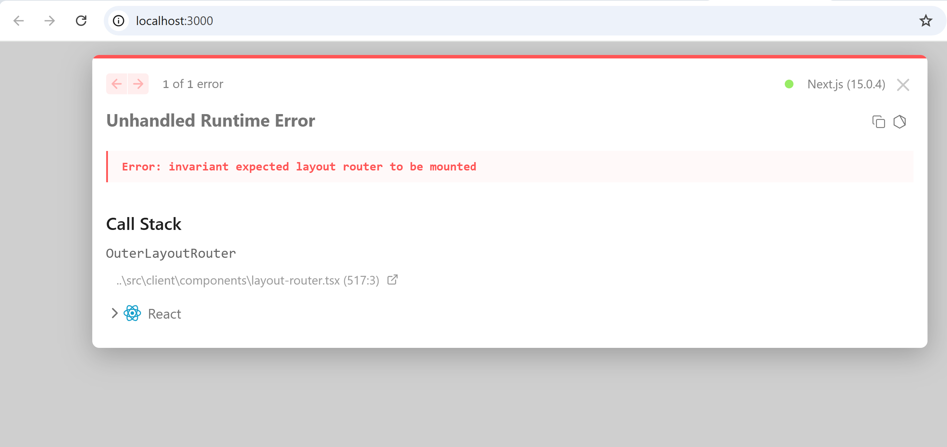
Joke ? next dev

Slide 9
new project using npx create-react-app

Slide 10
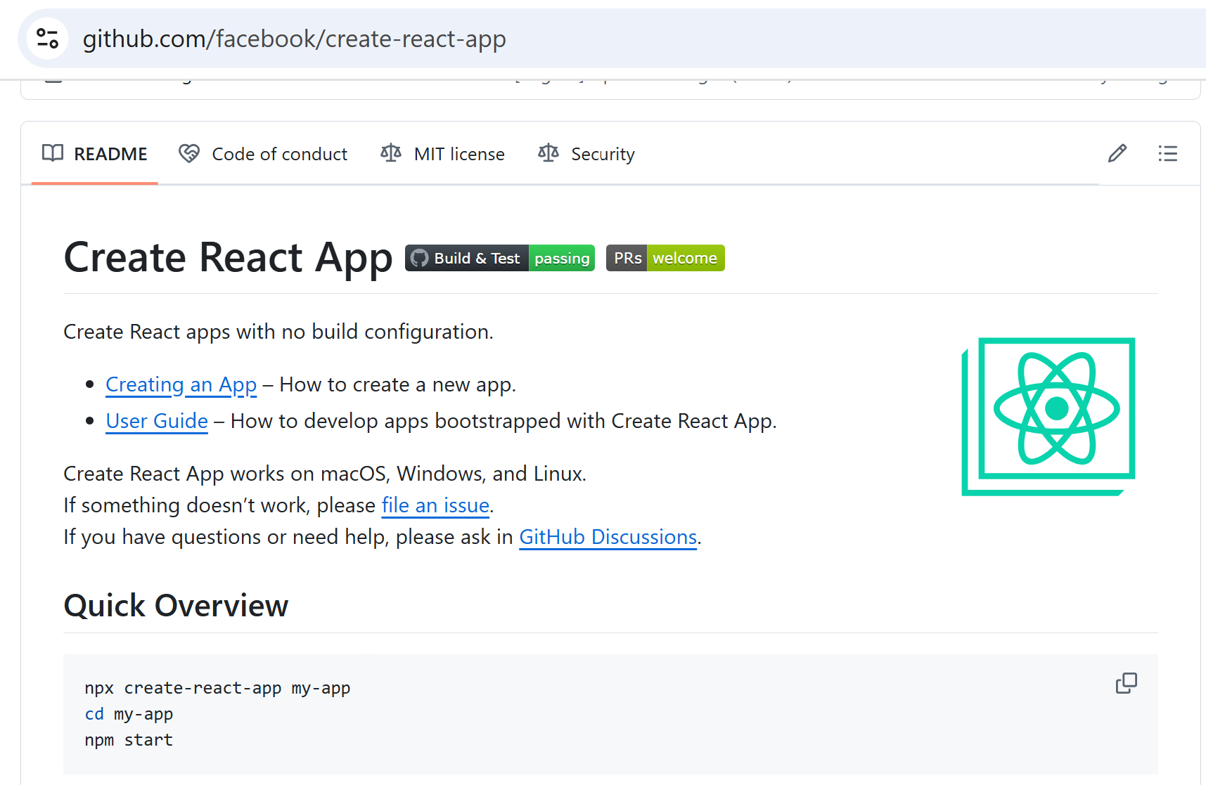
cf code generator: https://github.com/facebook/create-react-app

Slide 11
npx create-react-app test
npx create-react-app my-app --template typescript
cd my-app
# for development mode
npm start
# dist
npm run build

Slide 12
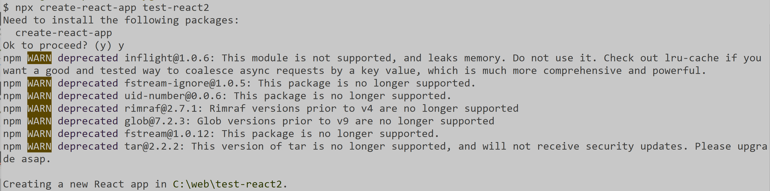
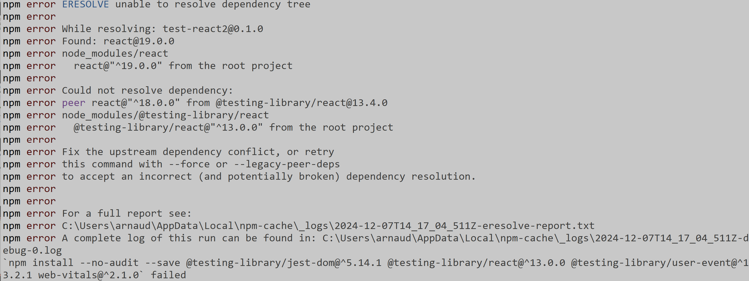
Joke ?

Slide 13
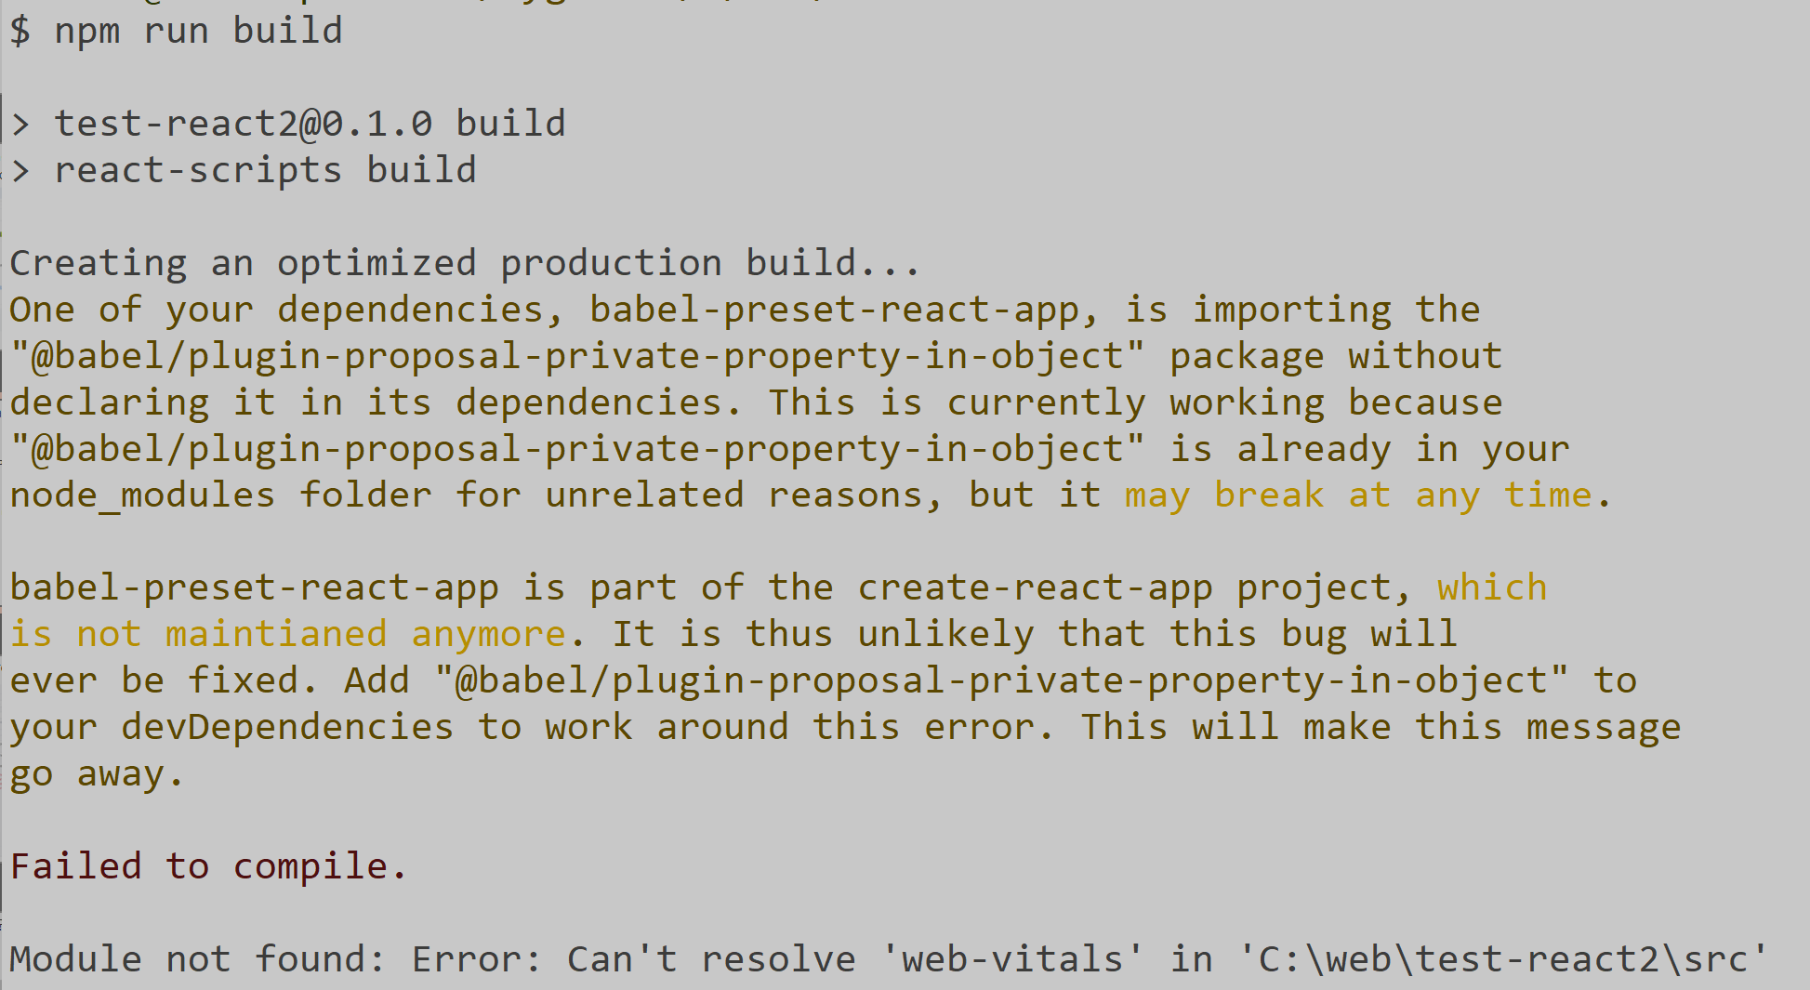
Joke ?

Slide 14
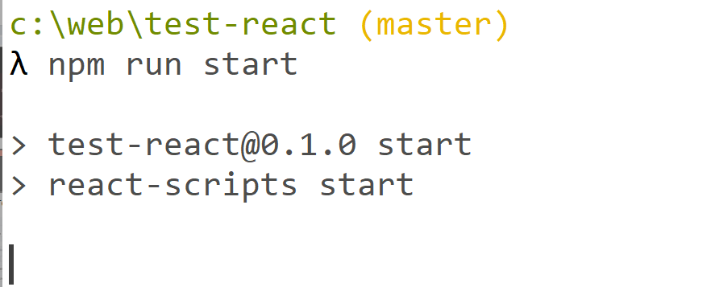
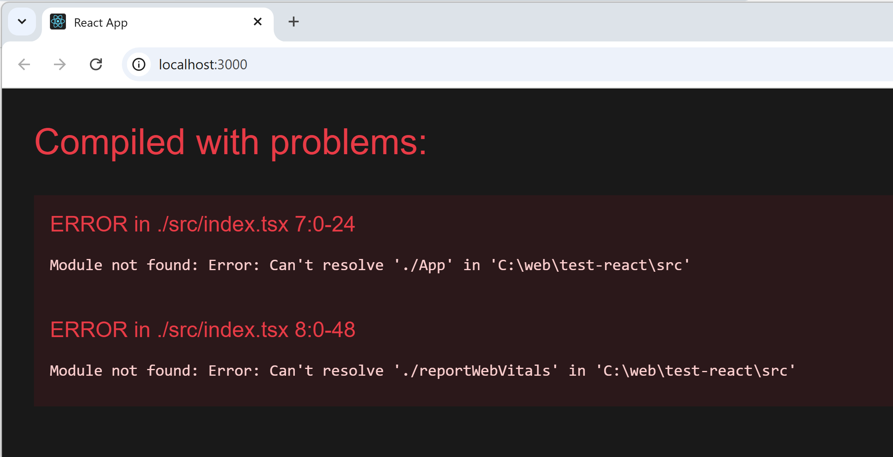
Joke ?

Slide 15
new project using Idea New Project

Slide 16
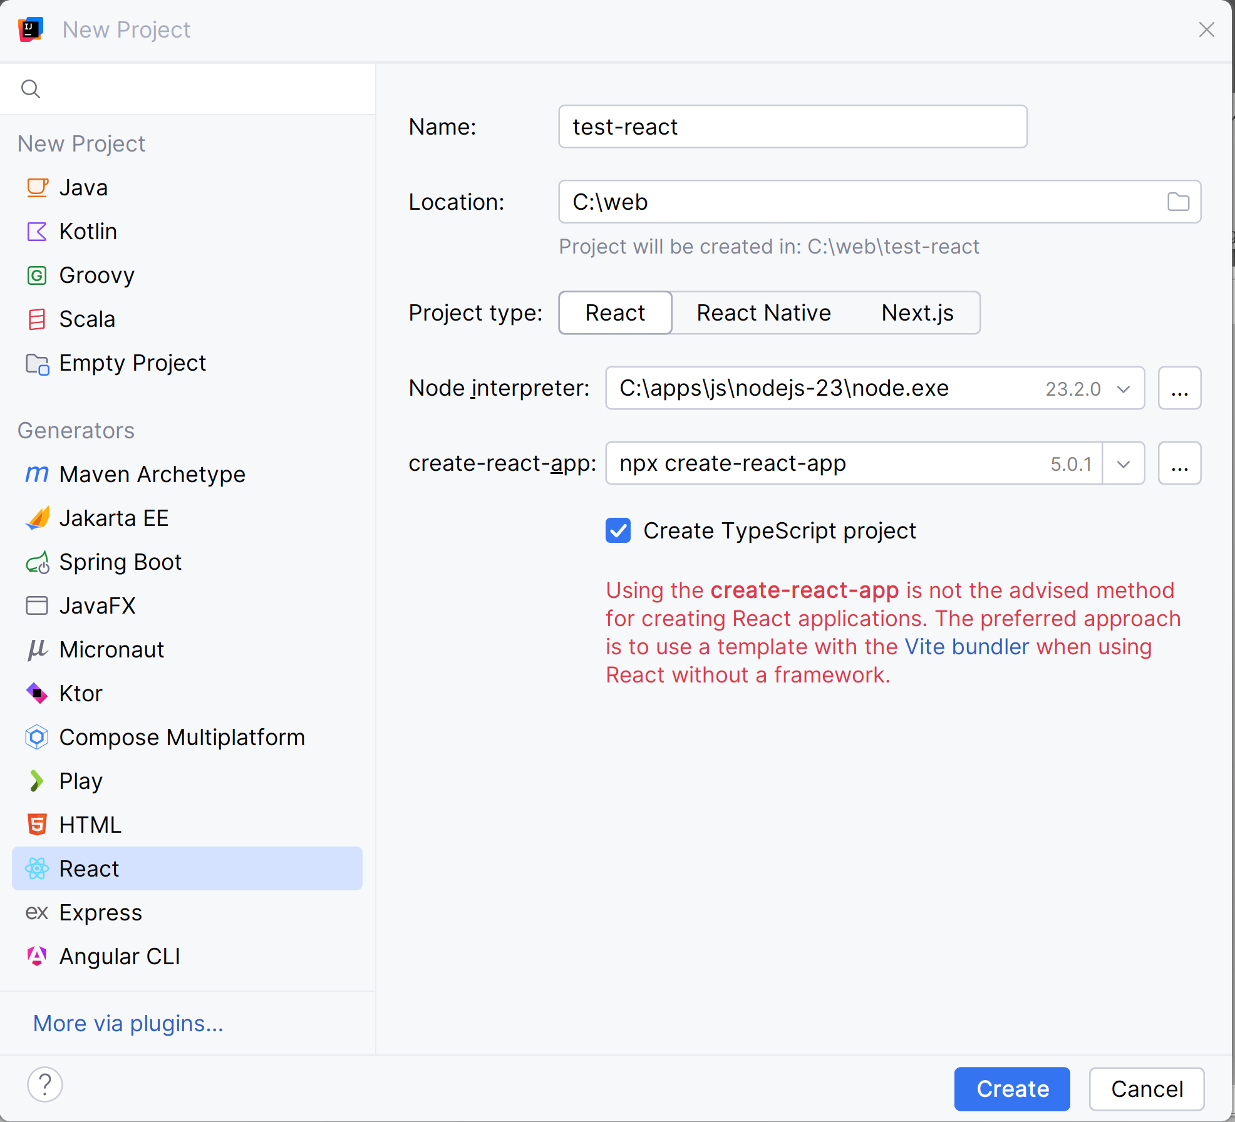
From Idea: New Project > "React"

Slide 17
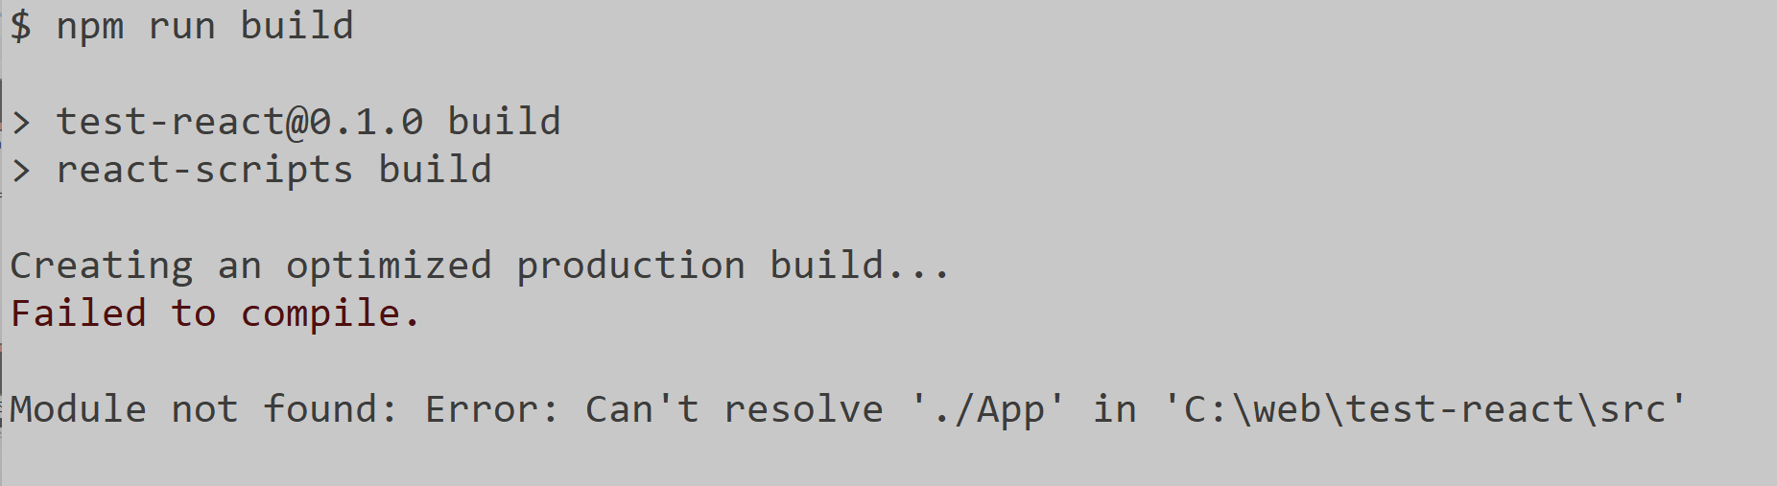
Joke?

Slide 18
Exploring a Minimal React App

Slide 19
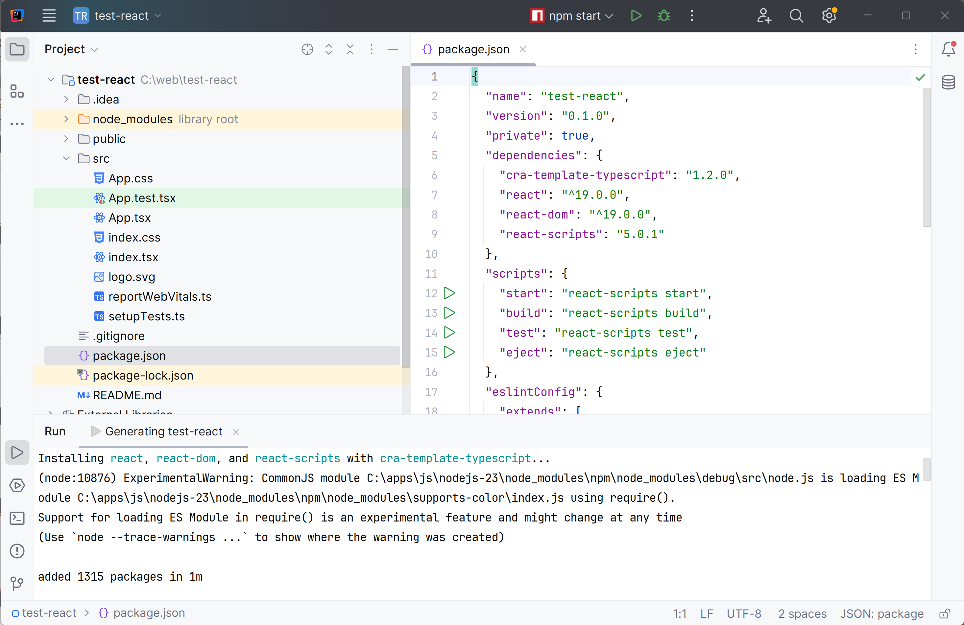
React TSX Project

Slide 20
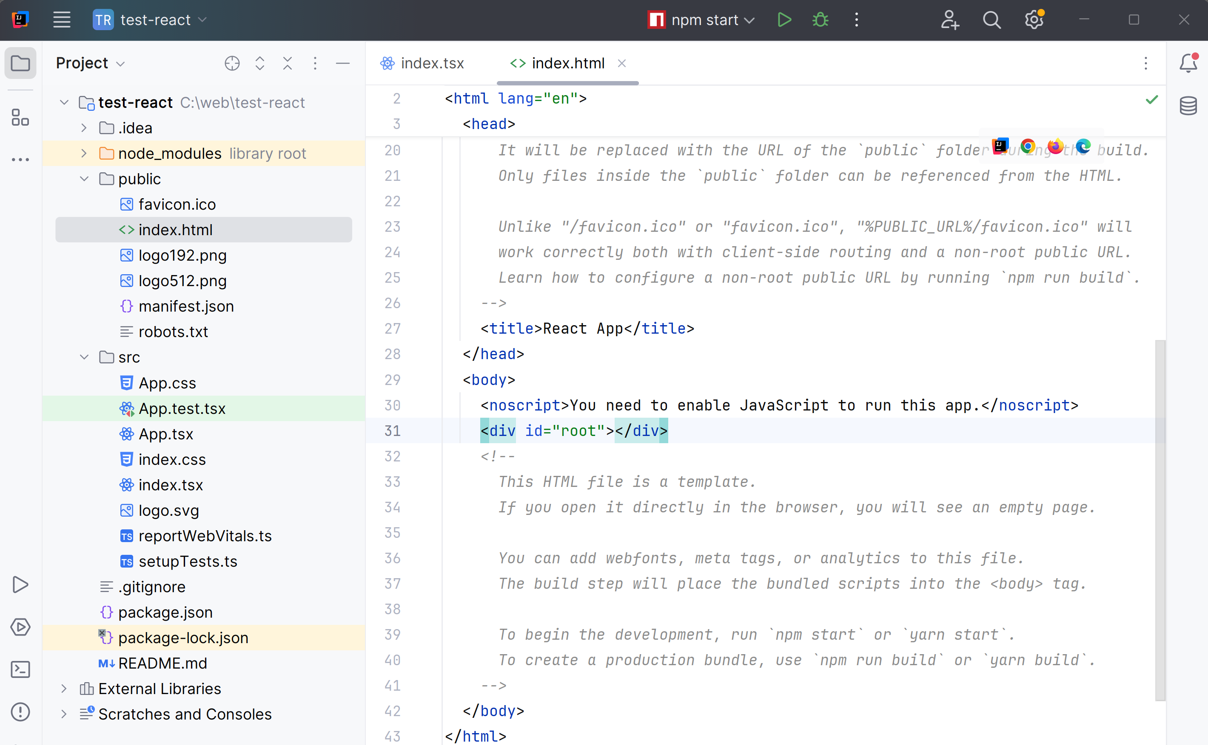
Index.html : Main Container for your App

Slide 21
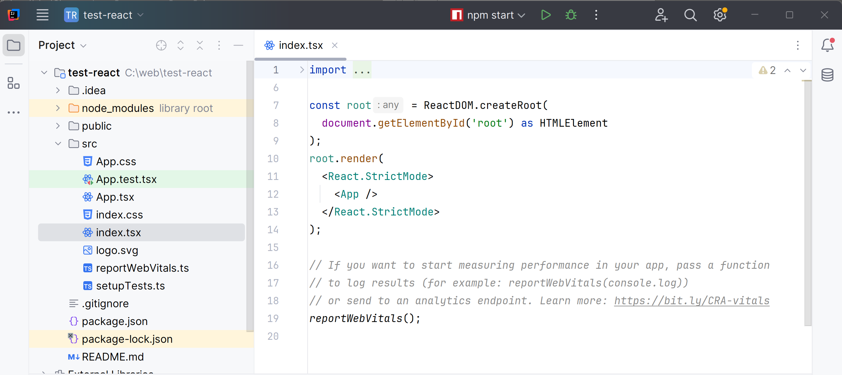
index.tsx : Main Bootstrapping App

Slide 22
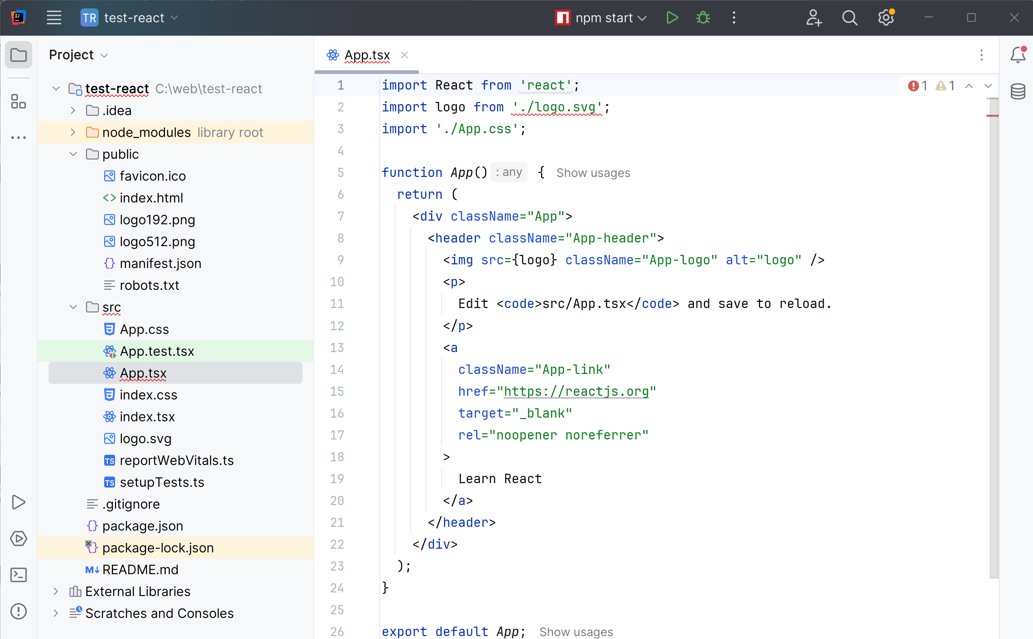
App.tsx

Slide 23
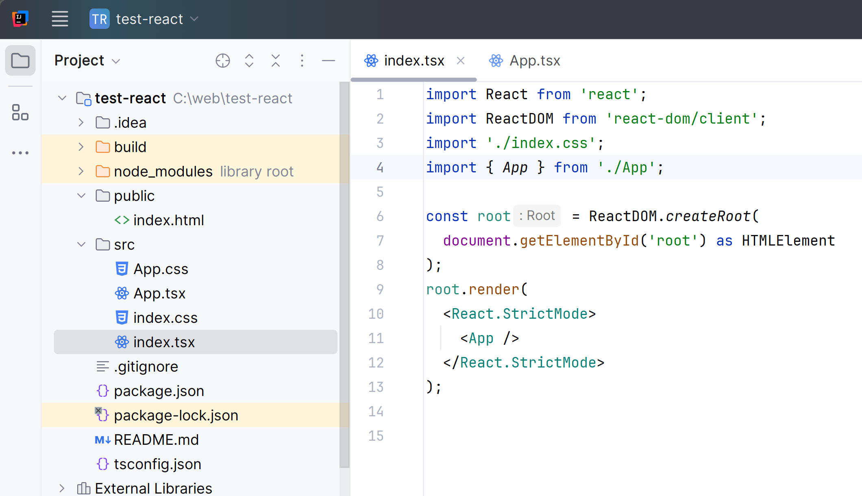
Cleanup Code.. (remove reportWebVitals and logos)

Slide 24
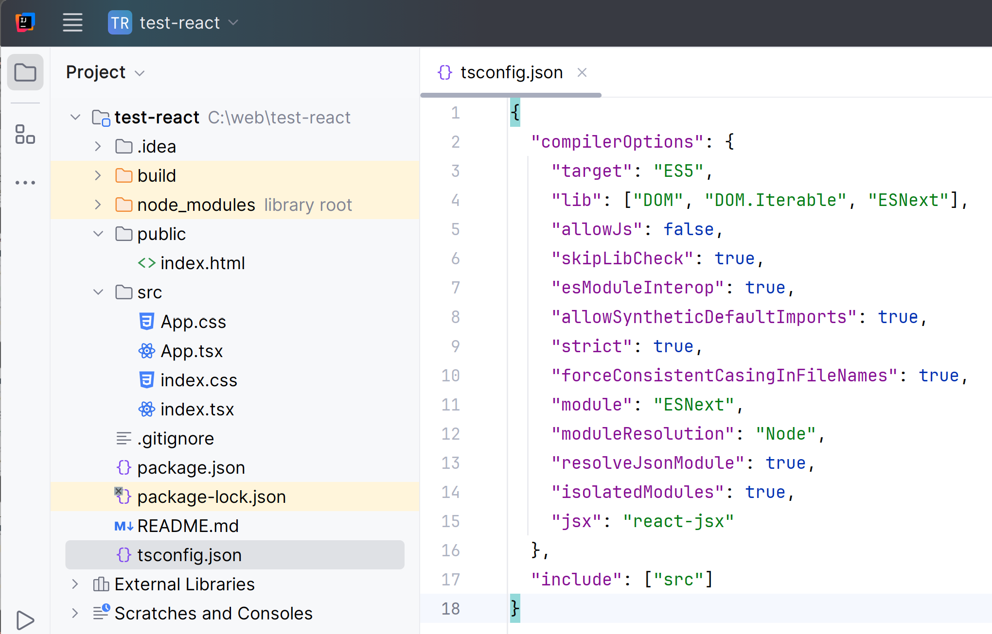
Added tsconfig.json

Slide 25
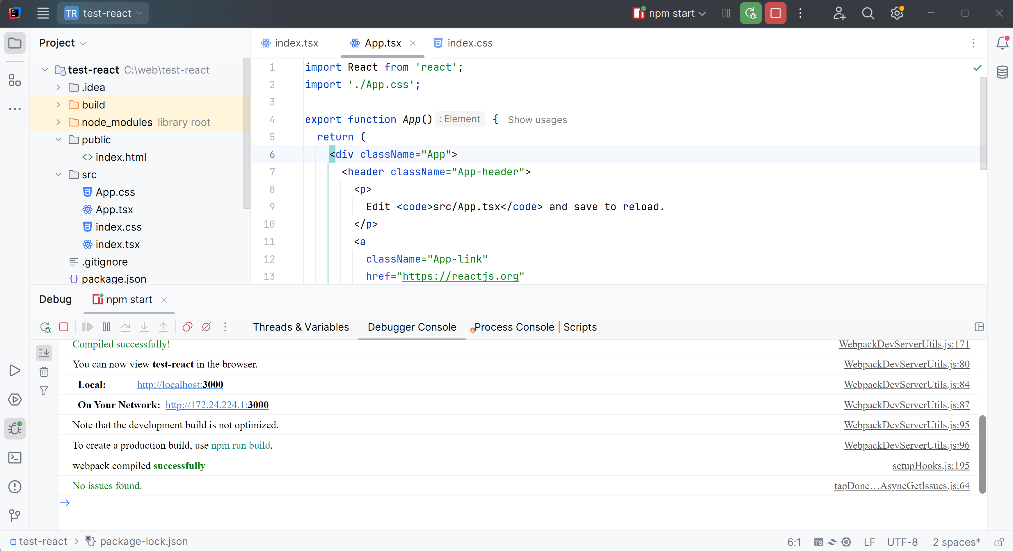
Idea Run / npm run start

Slide 26
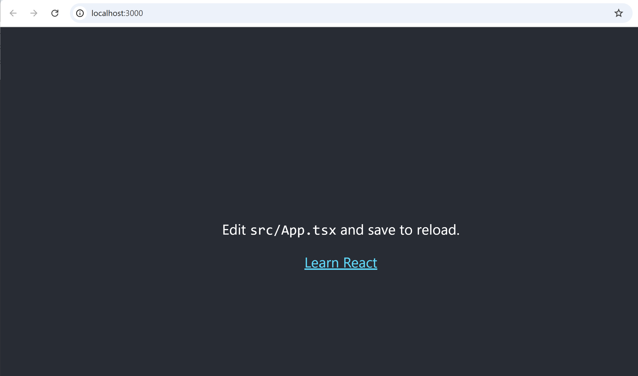
It (Finally) Works

Slide 27
Conclusions
BUGS occured as of 2024-12
even supposed stable Codes generator are BUGGY
Do not use "@latest" npm versions
Better copy from a working one
( Better to use JHipster )
You can (try to) struggle to fix them
Bugs will be hopefully fixed soon

Slide 28
Questions ?

